Slide 1
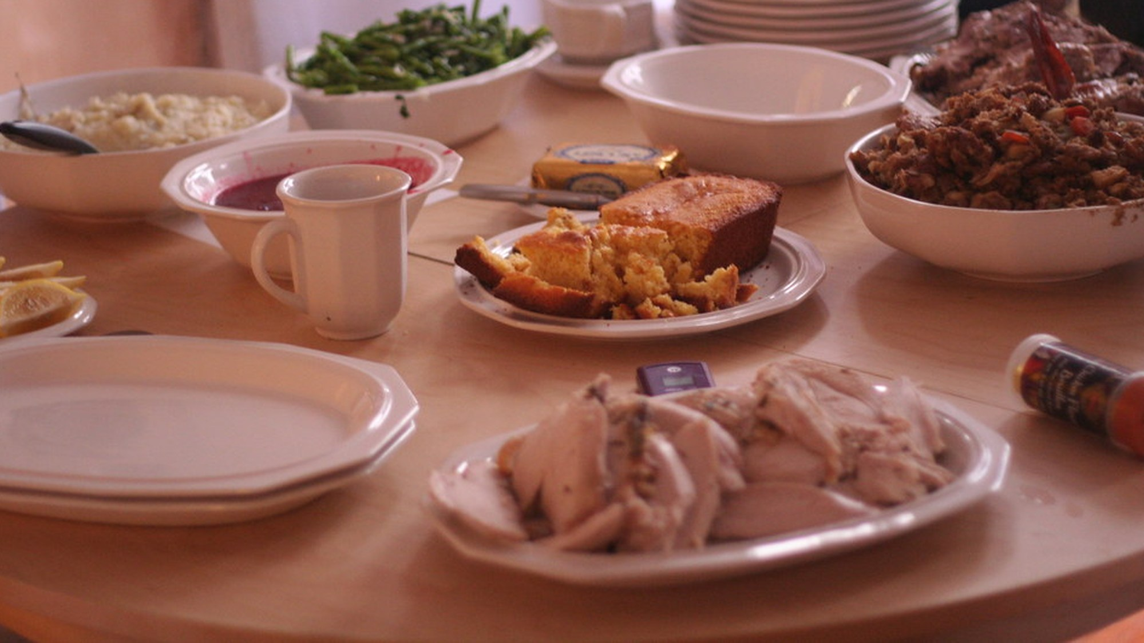
FAMILY GATHERING
Thanksgiving at the Randalls
Thursday, November 26, 2026, 4218 Sequoia Avenue, Baltimore
Doors at 2:00 PM, dinner at 4:00 PM | First gathering with Marcus home

Slide 2
THE MENU
Who Brings What
Dish | Assigned to | Servings | Status
Roast turkey, grilled | Samuel | 16 | Bought
Baked mac and cheese | June | 16 | Bought
Cornbread | June | 16 | Bought
Collard greens | June | 16 | Bought
Sweet potato pie | Marcus brings | 12 | Planned
Potato salad | Karen brings | 12 | Confirmed
Green bean casserole | Neighbor Gloria | 10 | Confirmed
Thanksgiving at the Randalls | 4218 Sequoia Avenue, Baltimore
2

Slide 3
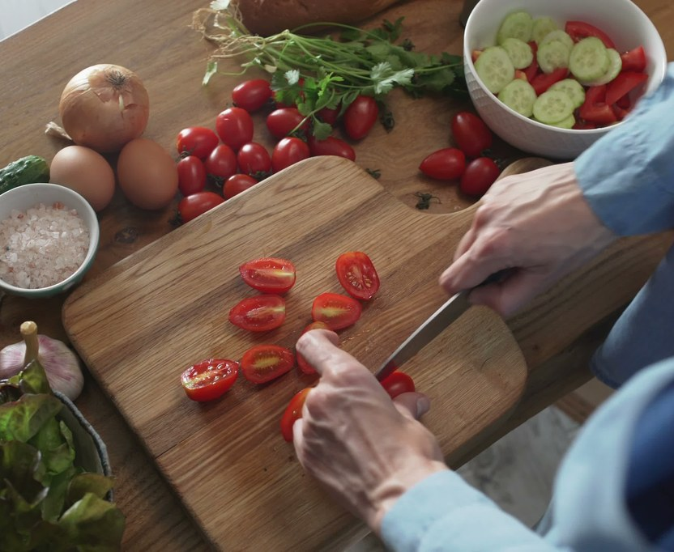
PREP
Kitchen Starts Wednesday
Done the night before, so Thursday stays calm.
• Cornbread and pies baked, greens prepped, table set.
• Thursday morning the turkey goes on the grill by 11:00 AM.
• Samuel handles the turkey, oven as backup if weather turns.
Thanksgiving at the Randalls | 4218 Sequoia Avenue, Baltimore
3

Slide 4
GUEST LIST
Fourteen at the Table
Guests | Count
Randall household, June, Samuel, Brianna, Marcus | 4
Lauren, traveling from Chicago | 1
Karen Mitchell, from Richmond | 1
Neighbor Gloria Pruitt and family | 3
Church friends, the Simms | 2
Deacon Reese and family | 3
Total expected | 14
Thanksgiving at the Randalls | 4218 Sequoia Avenue, Baltimore
4

Slide 5
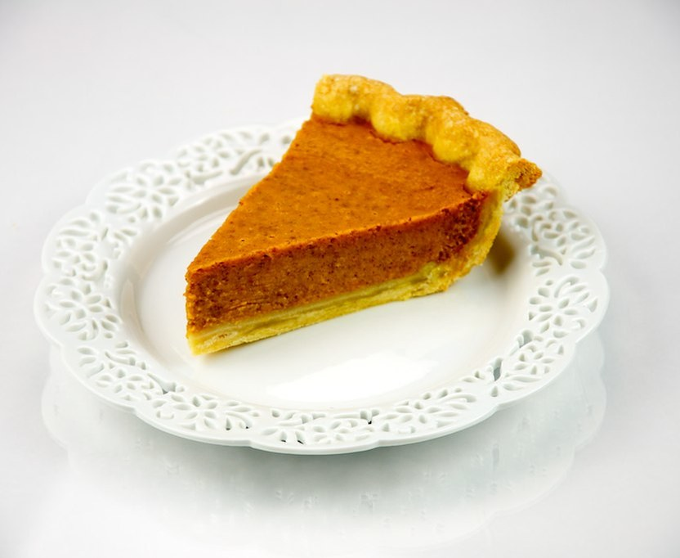
DESSERT
Save Room
Sweet potato pie and lemon bars when the coffee comes out.
• Marcus brings the pie home from Ridgewater.
• Neighbors and church friends welcome for dessert and coffee.
• Strong tea poured all afternoon.
Thanksgiving at the Randalls | 4218 Sequoia Avenue, Baltimore
5

Slide 6
KITCHEN SCHEDULE
Three Days, One Dinner
When | Task
Tuesday | Grocery run and brine the turkey
Wednesday | Bake cornbread and pies, prep greens, set the table
Thursday morning | Turkey on the grill by 11:00 AM, sides staged
4:00 PM | Blessing, then we eat
Thanksgiving at the Randalls | 4218 Sequoia Avenue, Baltimore
6

Slide 7
AT THE TABLE
A Table Worth Gathering Around
• Strong tea, family recipes, and no phones at the table.
• Yes, that means you, Brianna.
• Neighbors and church friends, come for dessert after dinner.
• Family and friends both have a seat at this table.
Thanksgiving at the Randalls | 4218 Sequoia Avenue, Baltimore
7

